Slide 1
CFD characterization of pressure drop and heat transfer inside Gyroid lattices.

Slide 2

Outline
Motivation
Methodology
Result and Discussion
Conclusion and Future Directions
CFD characterization of pressure drop and heat transfer inside Gyroid lattices structures.
Notes:
<number>

Slide 3
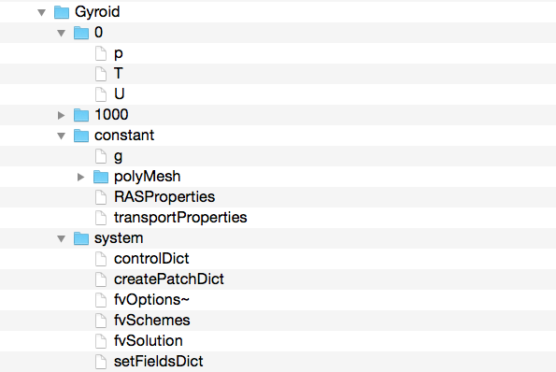
OpenFoam case set up
Case folder
Initial conditions
Time step directory
Constant settings
Mesh information
Simulation settings
CFD characterization of pressure drop and heat transfer inside Gyroid lattices structures.
Notes:
<number>

Slide 4
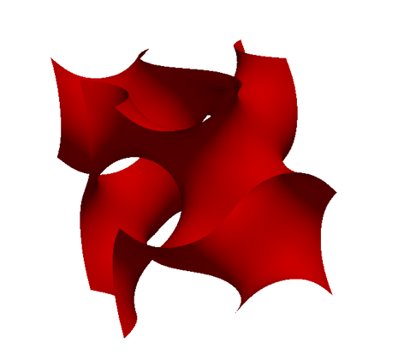
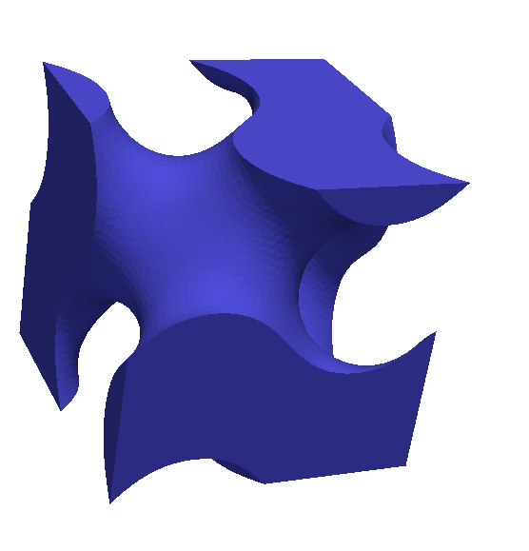
Aims and Objective
Investigate the thermal performance of targeted lattice structures at a unit cell level.
The Gyroid minimal surface used as interface between the fluid and the solid:
Model for pressure drop and heat transfer of the flow through the gyroid as a function of the Reynolds number.
CFD characterization of pressure drop and heat transfer inside Gyroid lattices structures.
AM enables the incorporation of complex lattice structures in metallic components. There is a great variety of lattice topologies, each having different thermal performance. The aim of this study is to investigate the thermal performance of targeted lattice structures at a unit cell level.
AM enables the incorporation of complex lattice structures in metallic components. There is a great variety of lattice topologies, each having different thermal performance. The aim of this study is to investigate the thermal performance of targeted lattice structures at a unit cell level.
AM enables the incorporation of complex lattice structures in metallic components. There is a great variety of lattice topologies, each having different thermal performance. The aim of this study is to investigate the thermal performance of targeted lattice structures at a unit cell level.
AM enables the incorporation of complex lattice structures in metallic components. There is a great variety of lattice topologies, each having different thermal performance. The aim of this study is to investigate the thermal performance of targeted lattice structures at a unit cell level.
Notes:
<number>

Slide 5
Methodology
Validation :
Manufacture of the test piece
Experimental evaluation
CFD analysis on the test piece
CFD at Unit Cell Level of lattices with varying unit cell size and volume fraction:
Developing a model for heat transfer and pressure drop in function of Re and Volume fraction.
CFD characterization of pressure drop and heat transfer inside Gyroid lattices structures.
Notes:
<number>

Slide 6
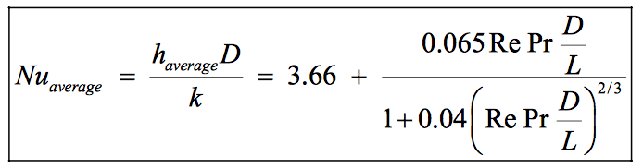

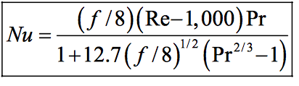
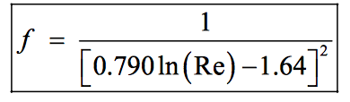
Cylindrical channel study
Comparison between testing, correlation and CFD for a cylindrical pipe.
Laminar Flow
Re <2300
Turbulent Flow
Re >4000
Re >10000
CFD characterization of pressure drop and heat transfer inside Gyroid lattices structures.
Notes:
<number>

Slide 7
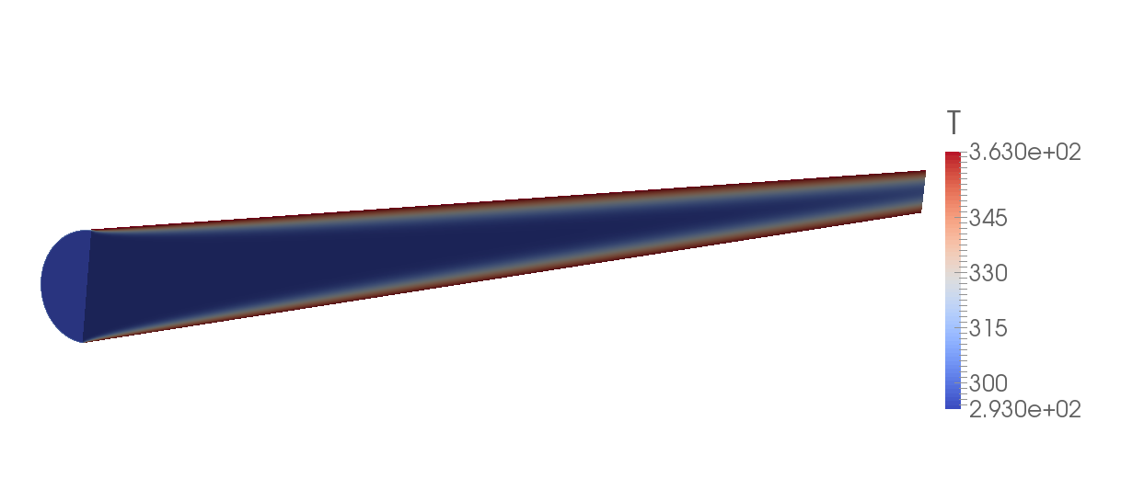
Cylindrical channel study
CFD set up
Dimension : D = 3mm and L = 90mm
Steady state simulations
Constant wall temperature
OpenFoam Solver used : BuoyantBoussinesqSimpleFoam
Various Reynolds numbers are modeled to cover different flow regimes.
CFD characterization of pressure drop and heat transfer inside Gyroid lattices structures.
Notes:
<number>

Slide 8
Cylindrical channel study
Experimental, Simulation and Correlation results
CFD characterization of pressure drop and heat transfer inside Gyroid lattices structures.
Notes:
<number>

Slide 9
Cylindrical channel study
Experimental, Simulation and Correlation results
CFD characterization of pressure drop and heat transfer inside Gyroid lattices structures.
Notes:
<number>

Slide 10
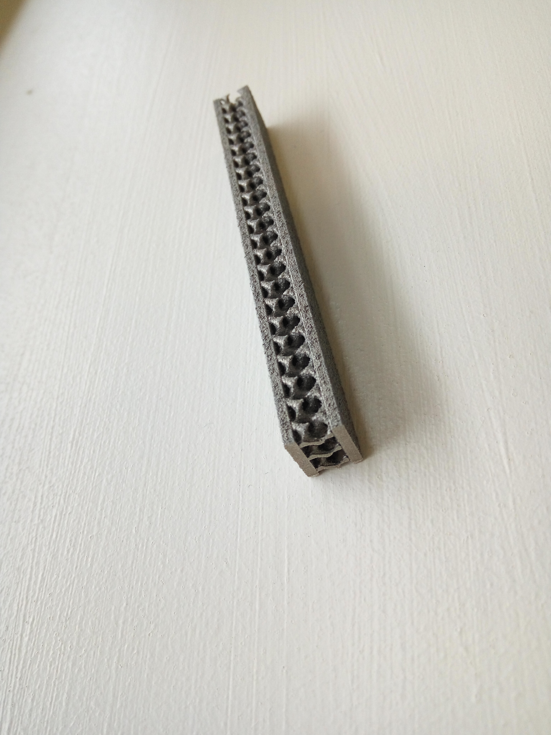
Gyroid test sample study
Lattice test specimen
Gyroid of 4mm cell size and 30% volume fraction:
Reynolds numbers tested :
- Re= 920
- Re=1840
- Re=2400
Test piece dimension: 11 mm x 9 mm x 90 mm
CFD characterization of pressure drop and heat transfer inside Gyroid lattices structures.
Notes:
<number>

Slide 11
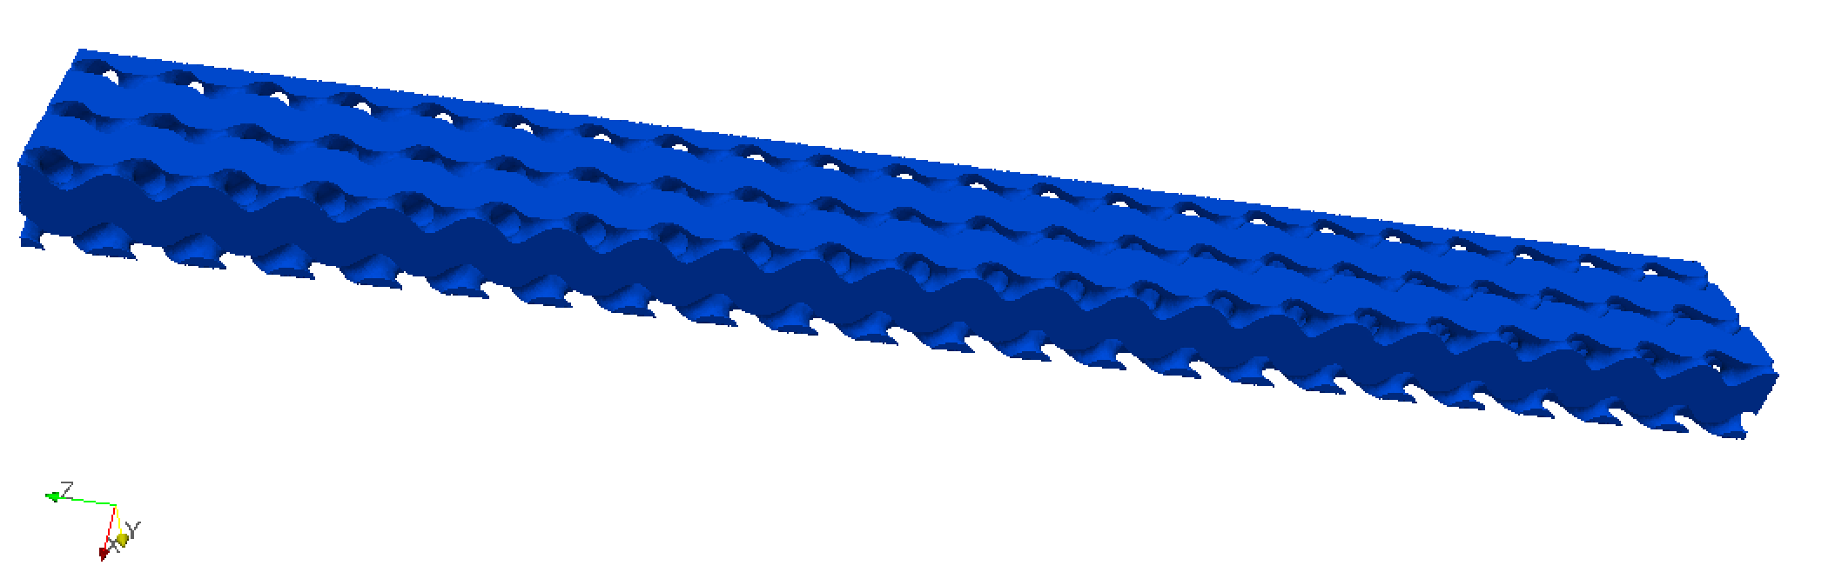
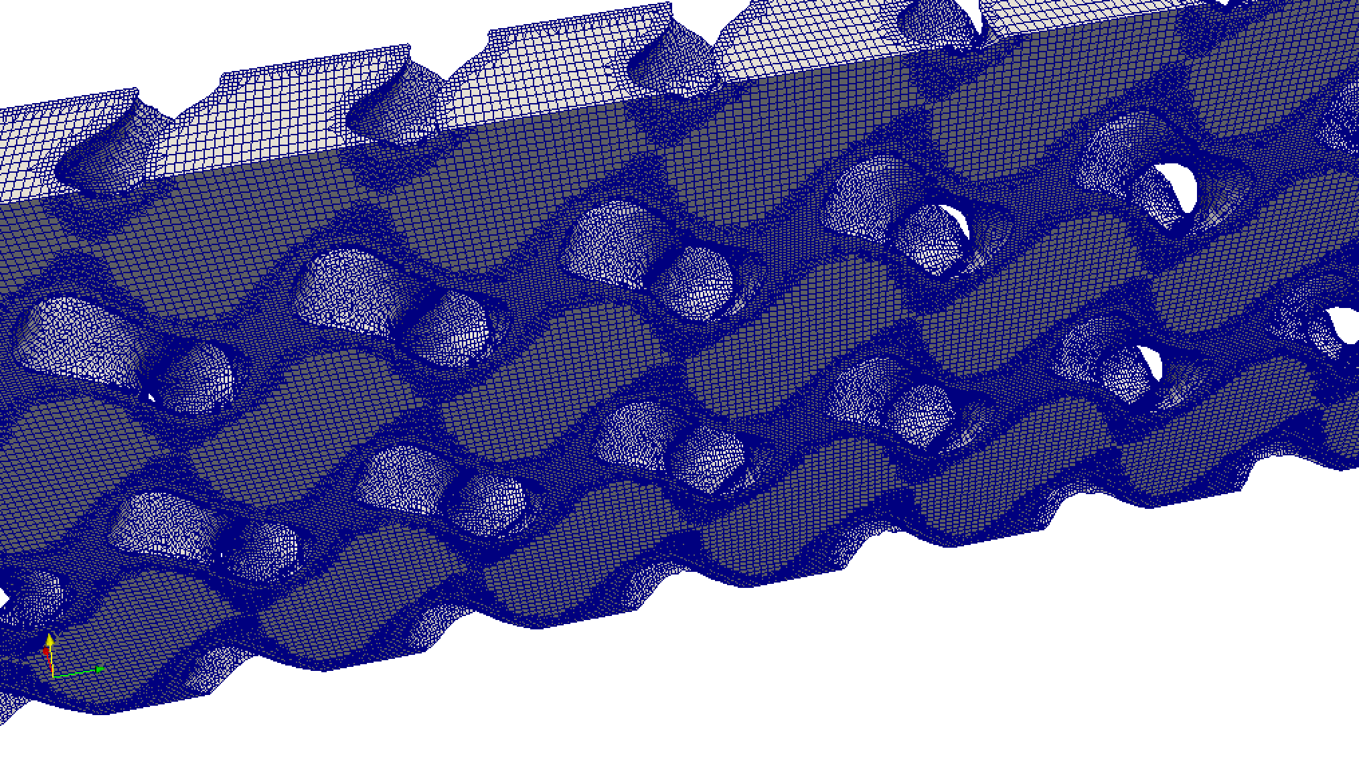
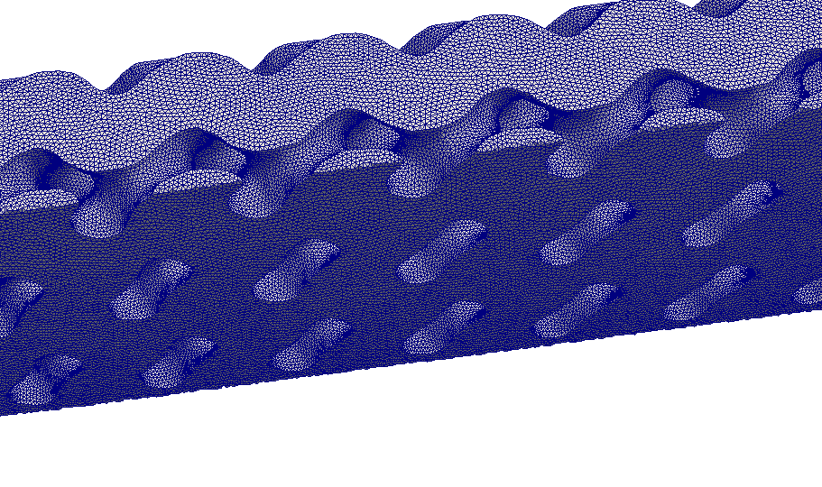
Gyroid test sample study
CFD set up
Steady state simulations
Constant wall temperature
OpenFoam Solver used : BuoyantBoussinesqSimpleFoam
CFD characterization of pressure drop and heat transfer inside Gyroid lattices structures.
Notes:
<number>

Slide 12
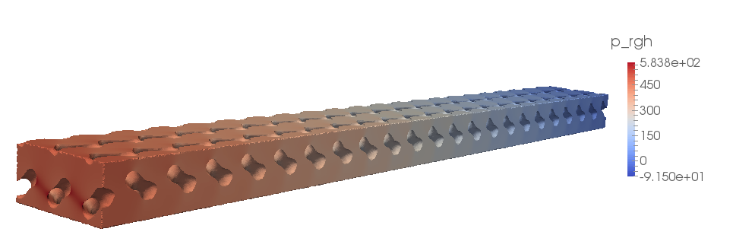
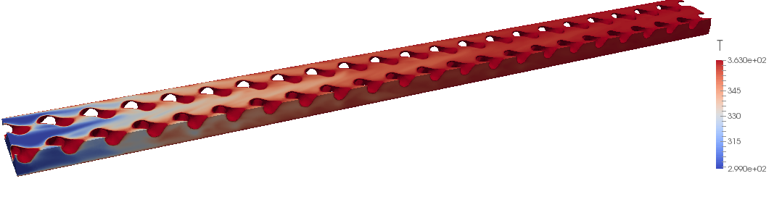
CFD results for Re=920
CFD characterization of pressure drop and heat transfer inside Gyroid lattices structures.
Notes:
<number>

Slide 13
Gyroid test sample study
Comparison between CFD and experimental results
CFD characterization of pressure drop and heat transfer inside Gyroid lattices structures.
Notes:
<number>

Slide 14
Conclusion
The CFD results of the cylindrical study are consistent with the correlation. The experiments show slightly different results.
The CFD analysis on the test piece shows consistent results compared to the experimental results.
The discrepancies between the experimental and modelled pressure drop can be explained by the roughness of the build part. Further analysis to be done to verify this point.
CFD characterization of pressure drop and heat transfer inside Gyroid lattices structures.
Notes:
<number>

Slide 15
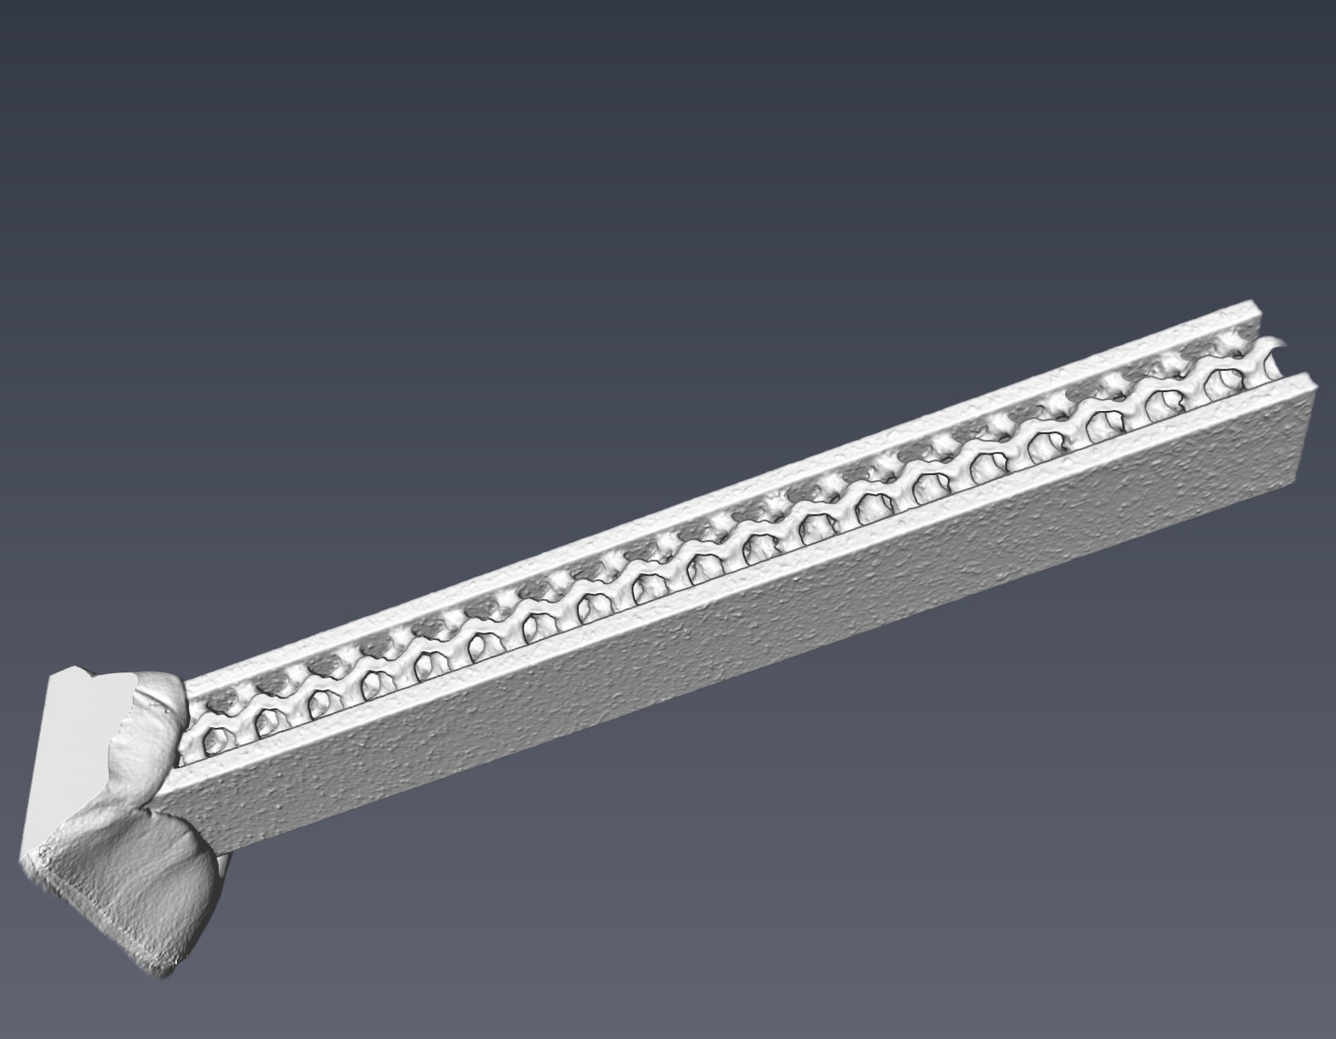
Current work
Micro CT-scan of the part and evaluate the impact of the manufacturing process on the heat transfer and pressure drop.
CFD characterization of pressure drop and heat transfer inside Gyroid lattices structures.
Notes:
<number>

Slide 16
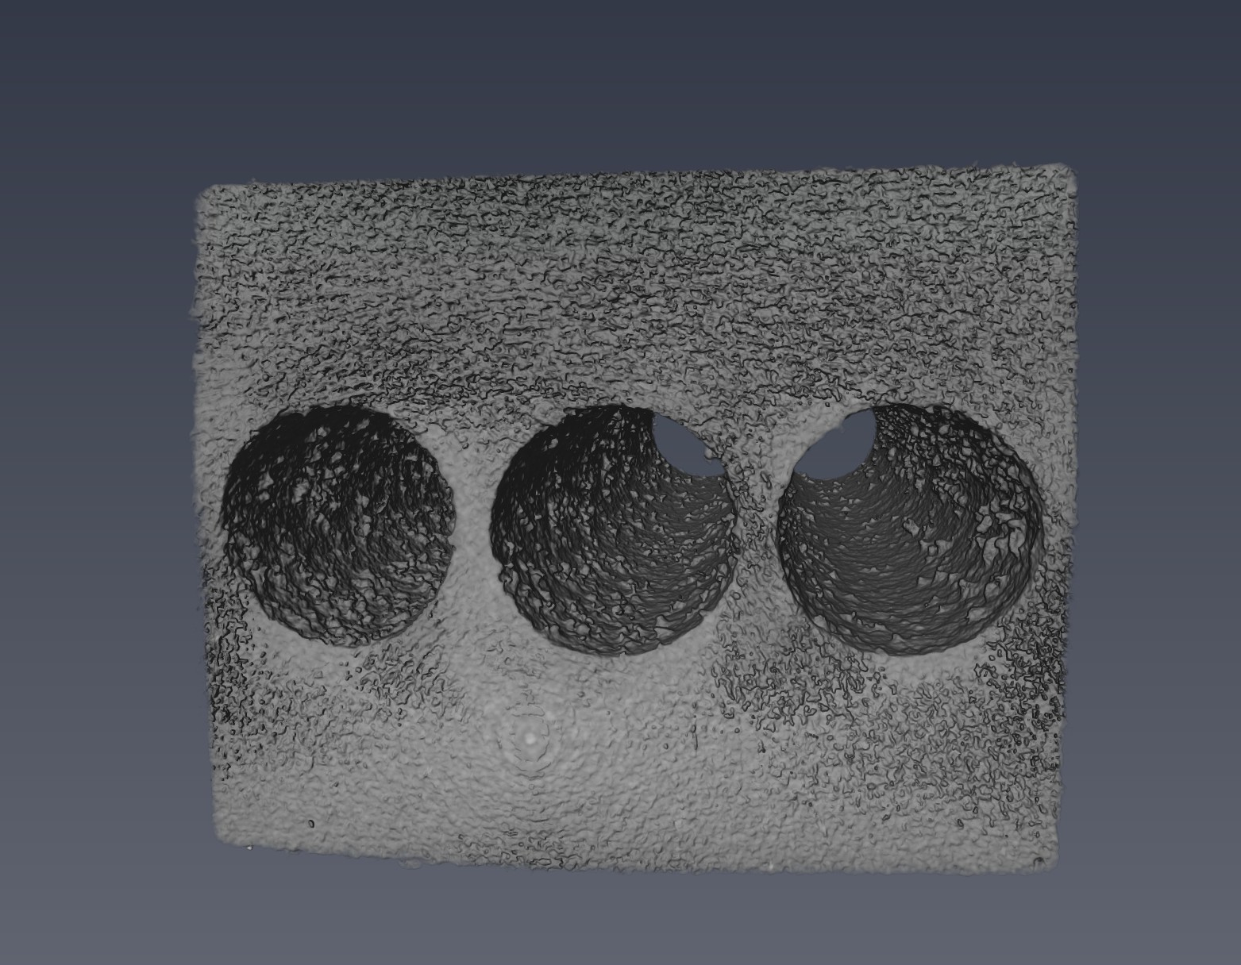
Current work
CFD characterization of pressure drop and heat transfer inside Gyroid lattices structures.
Notes:
<number>

Slide 17
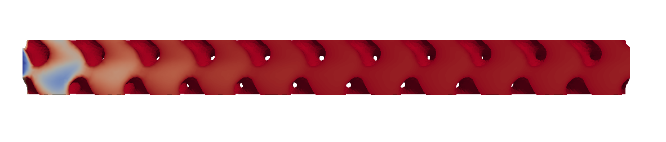
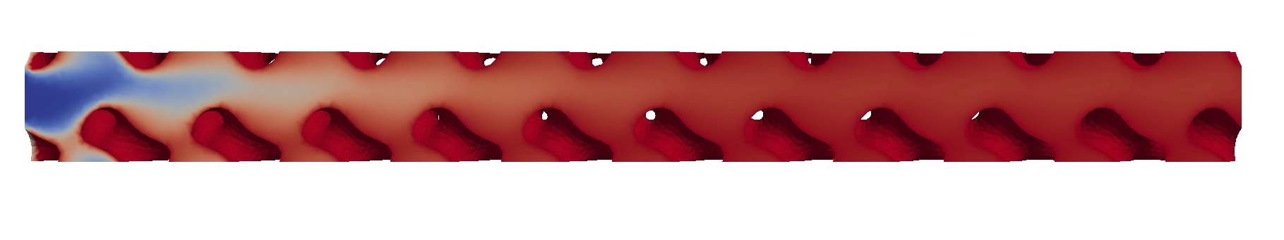
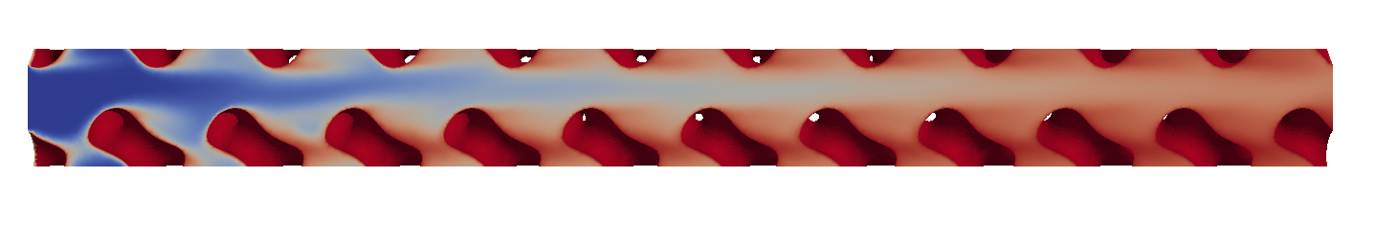
Current work
Run the CFD at the unit cell level for several configurations and develop a model for heat transfer and pressure drop.
Re= 50
Re= 100
Re= 500
CFD characterization of pressure drop and heat transfer inside Gyroid lattices structures.
Notes:
<number>

Slide 18
Current work
VF 30%
CFD characterization of pressure drop and heat transfer inside Gyroid lattices structures.
Notes:
<number>

